Slide 1
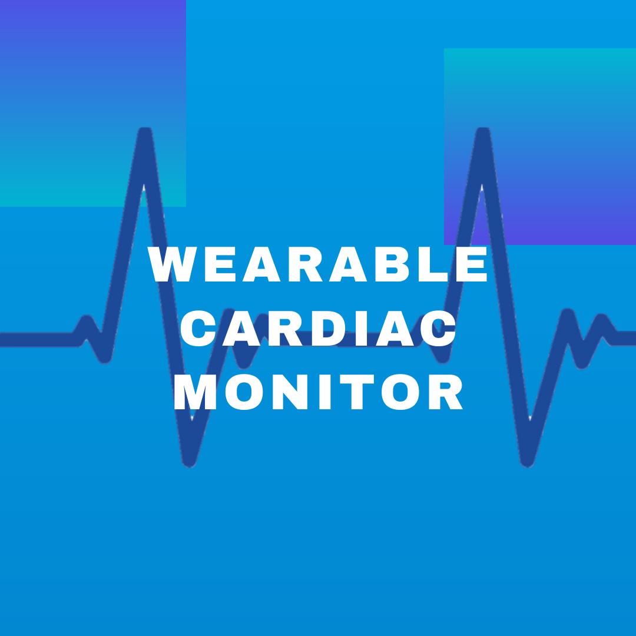
Members of Team 24
Andrew O’Brien
Peyton Sher
Ruiyu Sun
Scott Beard
Sam Kimball
Vincent Lazzaro
Client/Adviser
Dr. Cheng Huang
http://sdmay20-24.sd.ece.iastate.edu/
Wearable Cardiac Monitor Team 24
Notes:
Sam

Slide 2
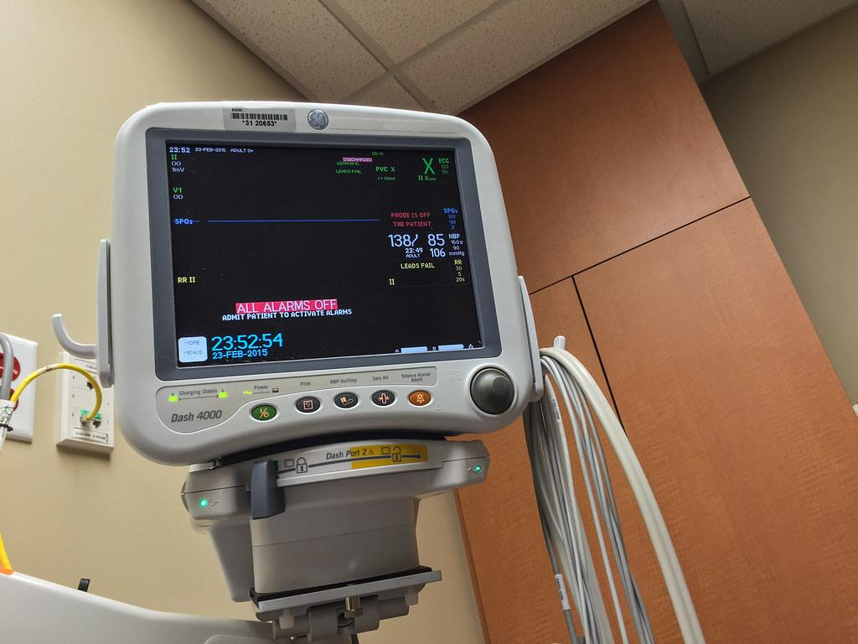
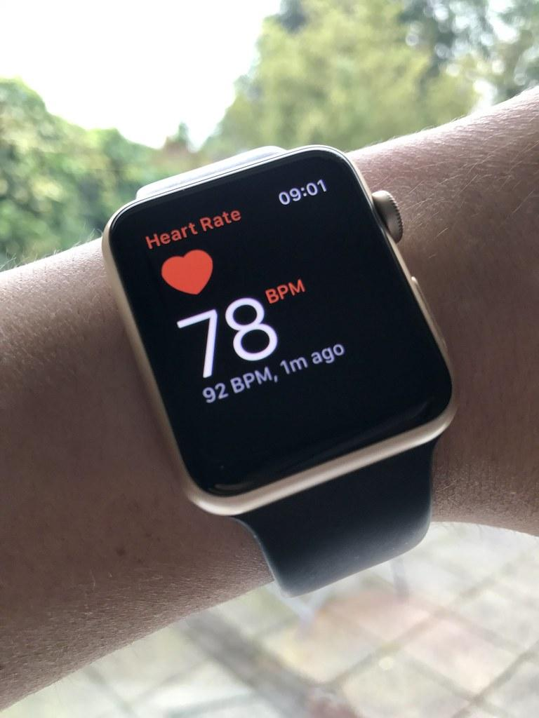
Project Vision
Our team spent the last two semesters building a compact, energy efficient, and user friendly heart rate monitor. This monitor was to be smaller than the typical heart rate monitor to allow the user to wear it in their normal daily lives.
Wearable Cardiac Monitor Team 24-Sam
Notes:
Sam - Talk about how our heart rate monitor will be more accurate than an Apple watch due to the electrodes
Turn it over to Andrew
Talk about plotting vs numbers on watches

Slide 3
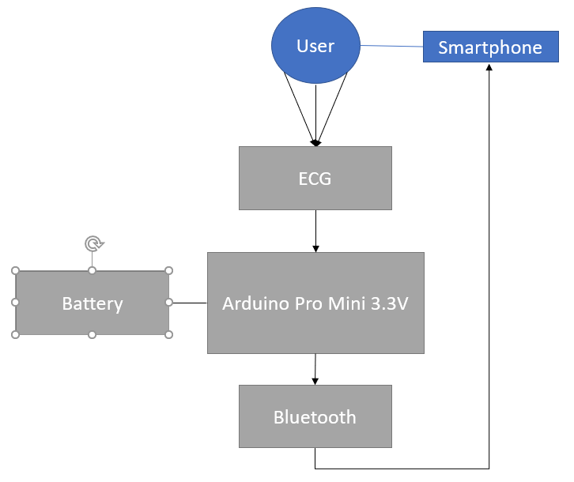
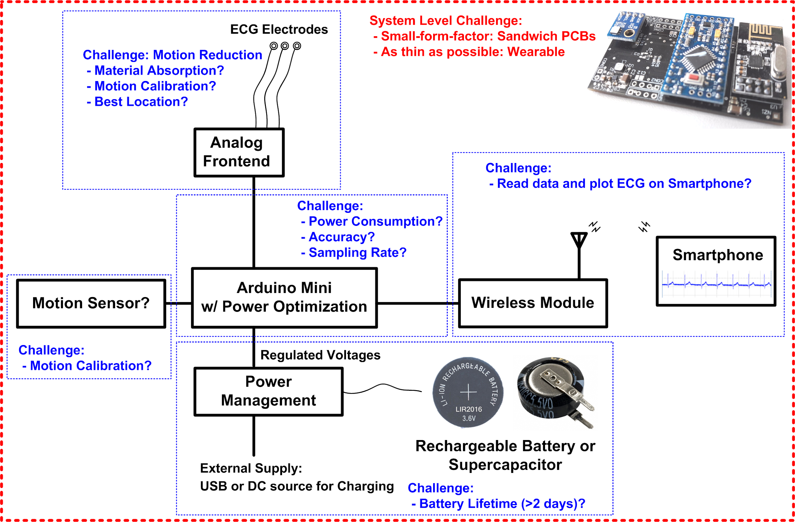
Concept Sketch
Wearable Cardiac Monitor Team 24-Andrew
Notes:
Andrew
We are hoping for multi-day use
We want the data readily available/ Live results
Secure signing in /use firebase

Slide 4
Design Requirements
Measurements
Continuous
Quality
ECG display
Send data via Bluetooth
View on smartphone (Android)
Runtime
48+ hour battery life
Wearability
Size
Comfort
Accessories
Memory
Android Device
App
Usability
User interface
Wearable Cardiac Monitor Team 24-Peyton
Notes:
Peyton

Slide 5
Technical Requirements
Bluetooth connectivity
Low power usage
Minimum operating voltages
Minimum Sizing
50 mm x 70 mm
Adequate sampling
Rechargable
Wearable Cardiac Monitor Team 24-Scott
Notes:
Scott

Slide 6
Operating Environment
Connected to the body
Handle condition involving physical activities, sweat, weather
Average daily conditions.
Able to wear to bed and while showering. 48 hrs continuous
Wearable Cardiac Monitor Team 24-Vincent
Notes:
Vincent

Slide 7
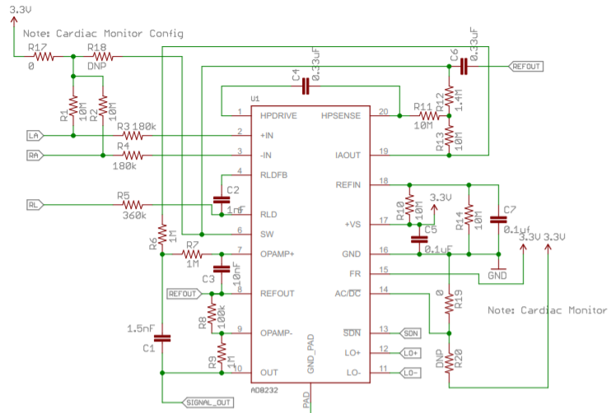
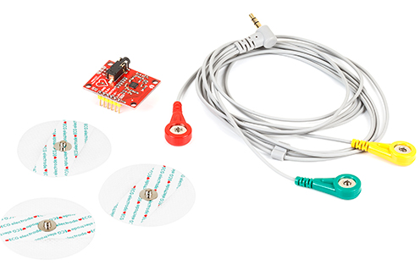
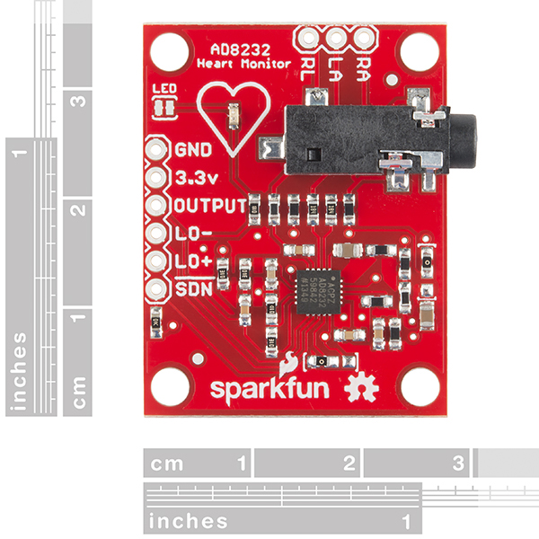
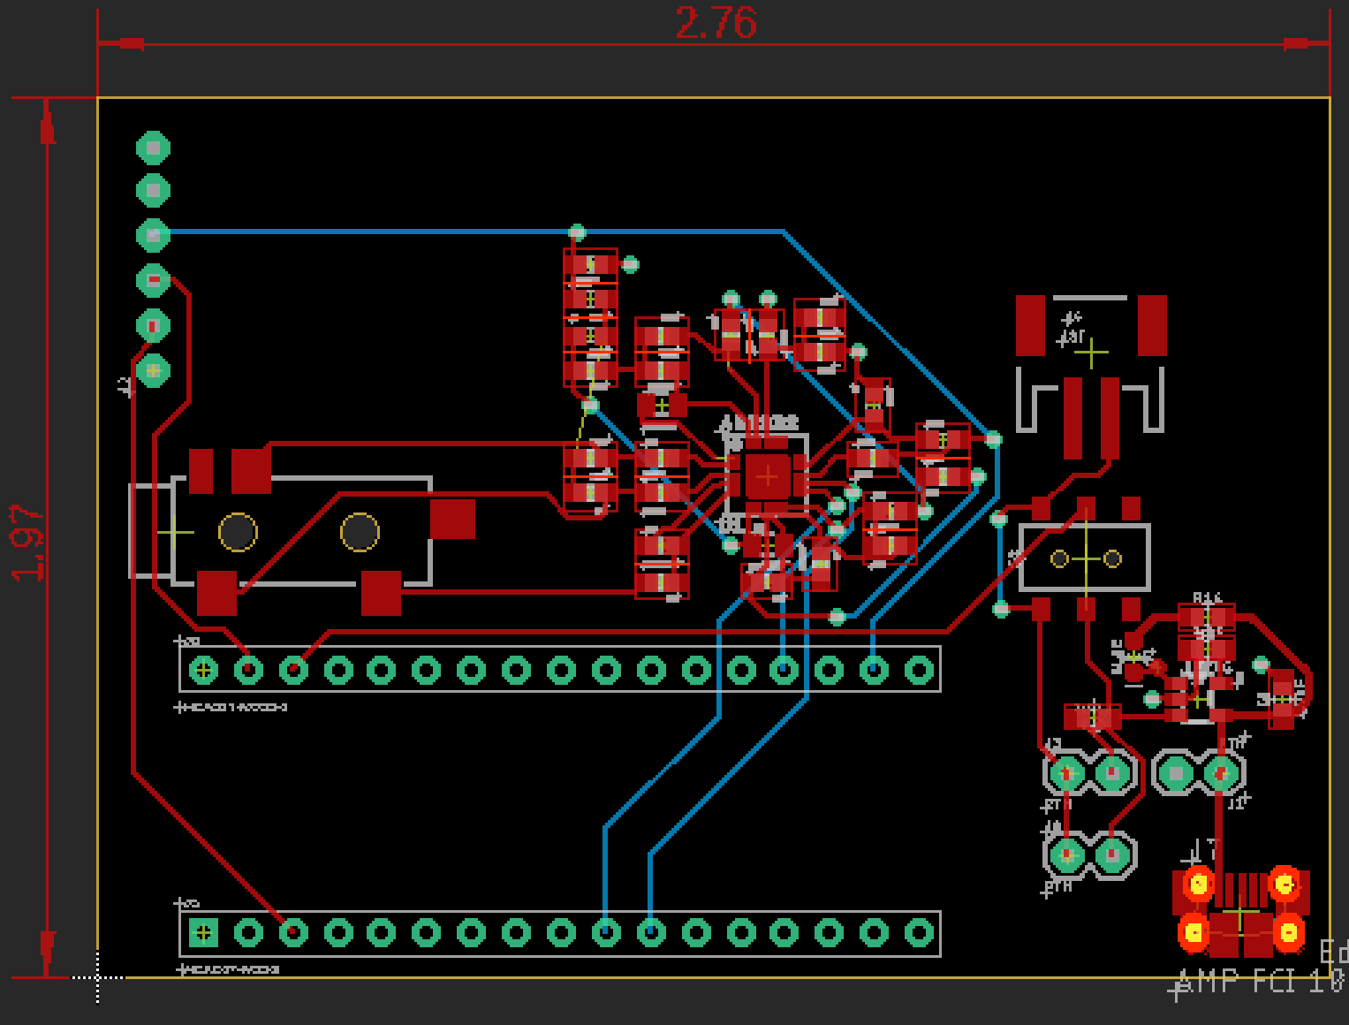
Hardware Design
https://learn.sparkfun.com/tutorials/ad8232-heart-rate-monitor-hookup-guide/all https://cdn.sparkfun.com/datasheets/Sensors/Biometric/AD8232_Heart_Rate_Monitor_v10.pdf
3-lead ECG reading
TRS Auxiliary connector
AD8232 Chip
New gel pad increases accuracy
3.7 V battery
Regulated VDD from Arduino
Wearable Cardiac Monitor Team 24-Ruiyu
Notes:
Ruiyu

Slide 8
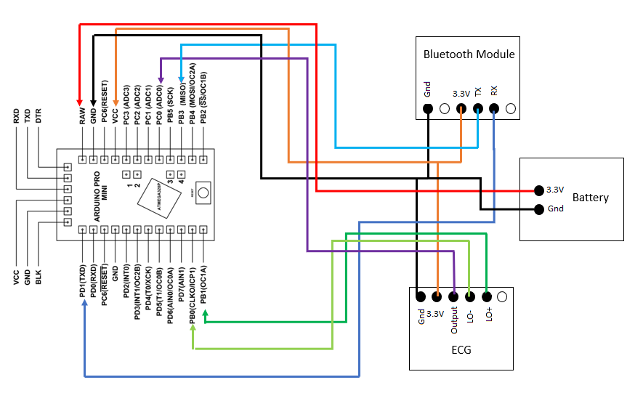
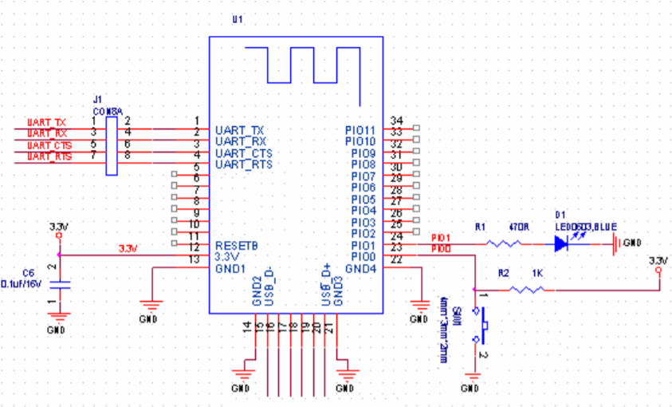
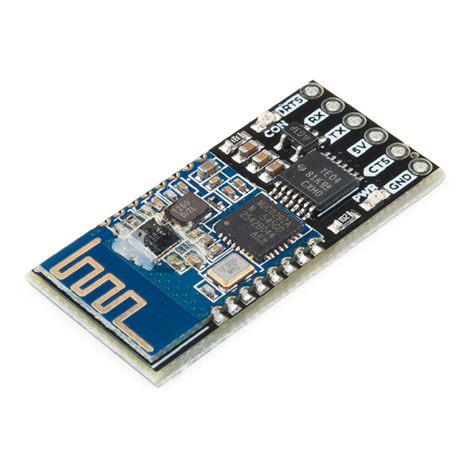
Communication Design
Arduino applications
Bluetooth Mate 4.0
System Design
https://www.arduino.cc/
https://www.sparkfun.com/products/14839
Wearable Cardiac Monitor Team 24-Vincent
Notes:
Vincent
We used arduino IDE for programming which uses a C language
How our program works
Wait phone is connected
Once phone is connected it starts to collected data sampling at roughly 100 samples per second
Two modes:
App is off we collect 100 samples then send in them all at once.
App is on we continuously sample and then send.
To help smooth out our signal to get rid of noise we have a running average and acceptance zone plus minus 100
We also have a low pass filter with a corner frequence of 20 Hz designed in to get rid of some noise as well.

Slide 9
Communication Design Issues
Maintaining bluetooth connectivity
Only send or receive data but not both causes a delay in data being sent over to the application
Redesigned bluetooth connection to help
Wearable Cardiac Monitor Team 24-Sam
Notes:
Sam → turnover to Andrew to talk about software side of project plan
Never got the interrupt to work correctly

Slide 10
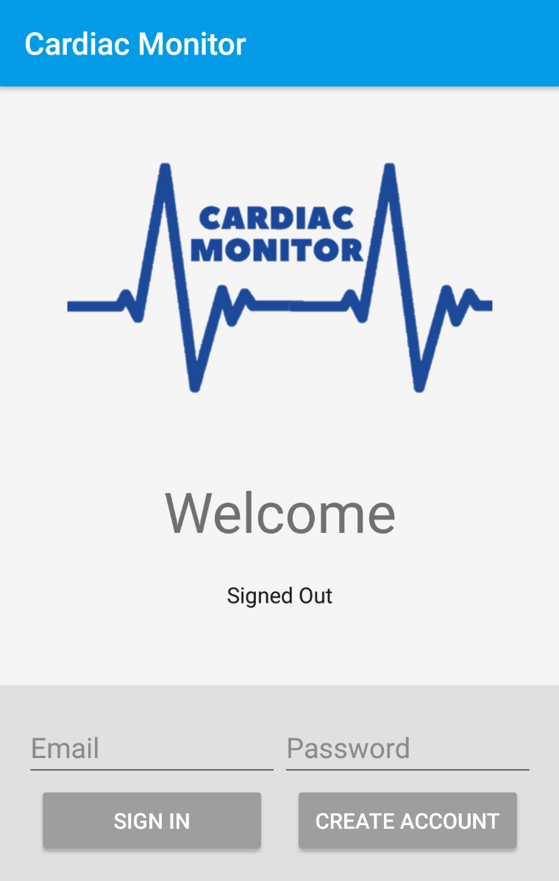
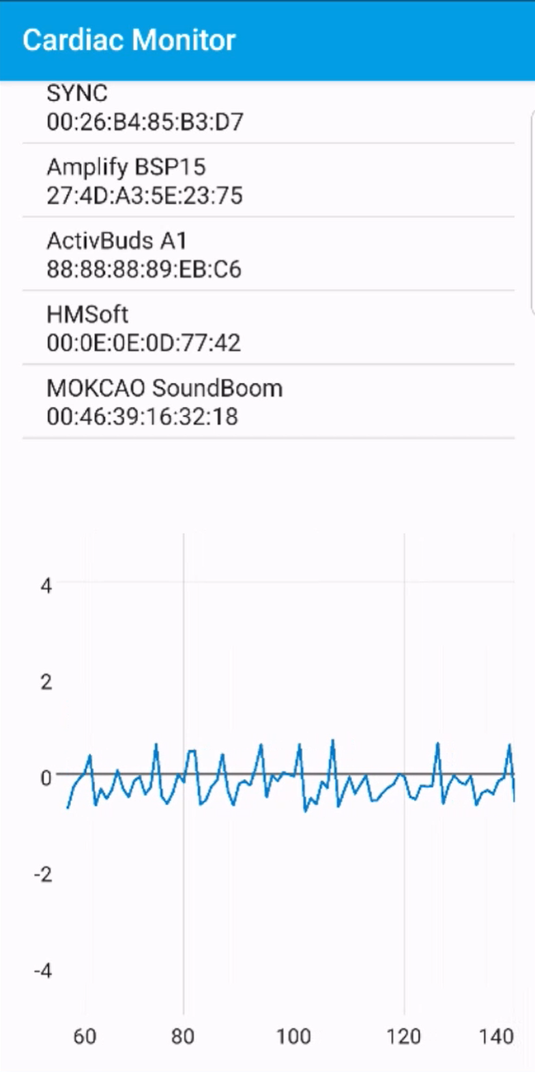
Software Design
Android Application which allows for tracking and storing Cardiac Information
Google FireBase Login
Similar to existing applications/user familiar
Allow user to export data
Maintain Bluetooth connection in background
Screenshots from our application
Wearable Cardiac Monitor Team 24-Andrew
Notes:
Andrew
Mention that the right picture is our user interface

Slide 11
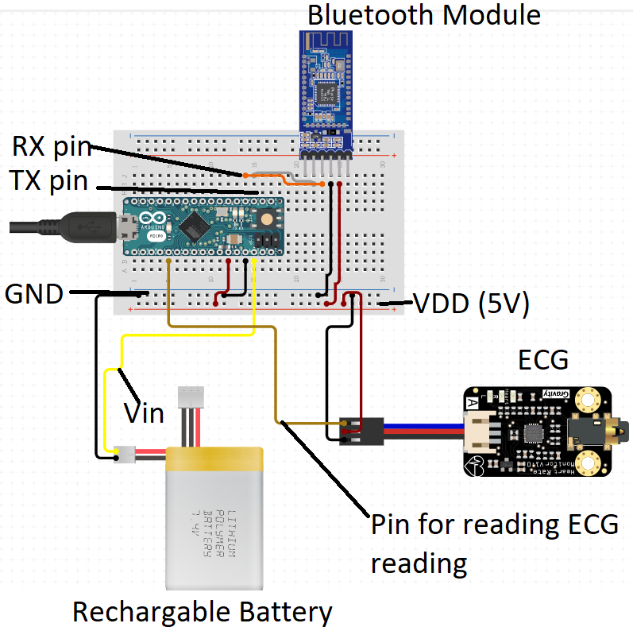
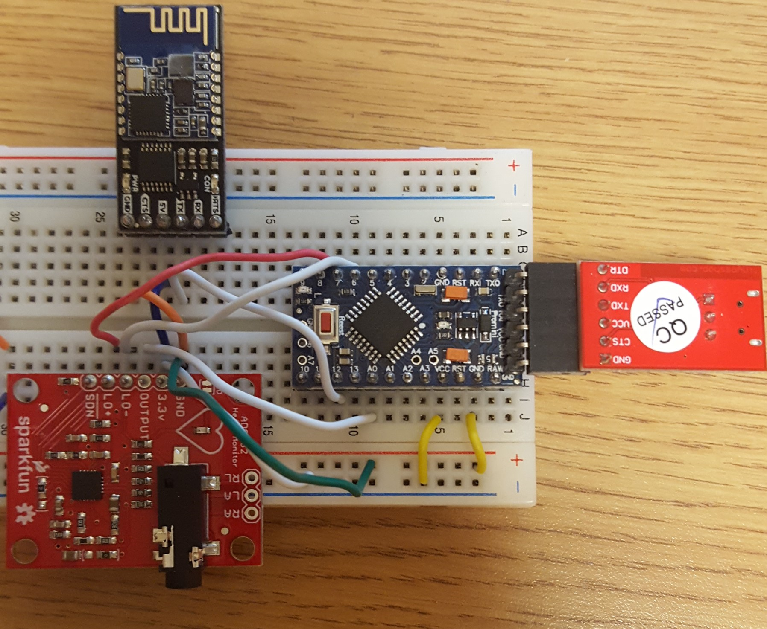
Prototype of Final Product
Wearable Cardiac Monitor Team 24-Vincent
Notes:
Vincent
This is our final design prototype without its case that we are working towards.

Slide 12
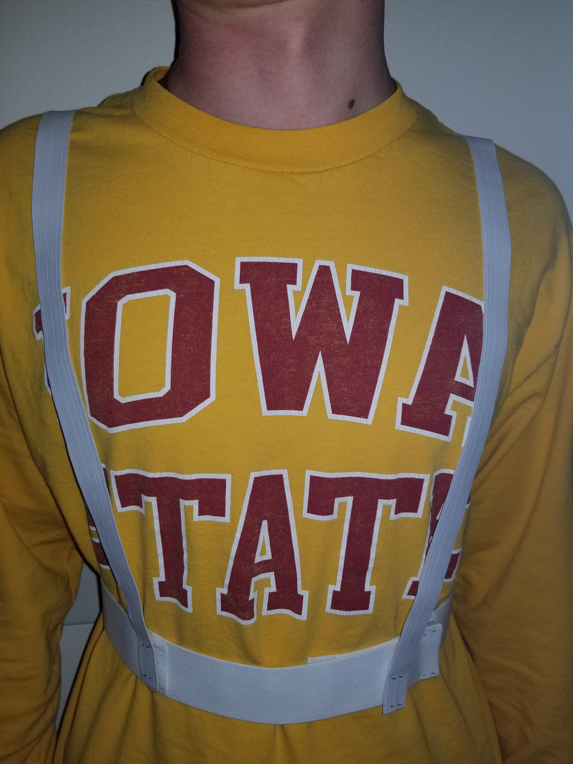
Final Product Design
Key Components
Functionality vs. Power
Small Form Factor (deck of cards)
Eliminate Noise
Style and Comfort
Remove wires and try flexible circuit board to remove noise (unable to implement)
Model of the adjustable strapping we planned to use to hold the device
Wearable Cardiac Monitor Team 24-Scott
Notes:
Scott

Slide 13
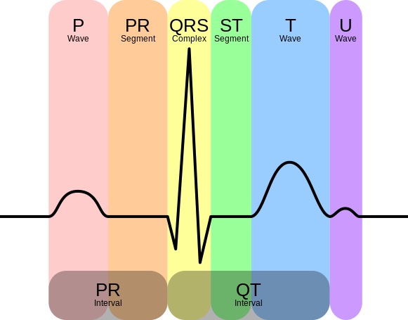
Using a Reference Heart Rate Monitor
BioPac
Old fashioned heart rate monitor
Weren’t able to run tests
Student Health Center
Cosette Scallon, MD
Helped us understand the important parts of a heartbeat wave
Gave us a readout of Vincent’s heartbeat
Wearable Cardiac Monitor Team 24-Ruiyu
Notes:
Ruiyu
Top right corner is the BioPac system we had
We talked with Cosette Scallon

Slide 14
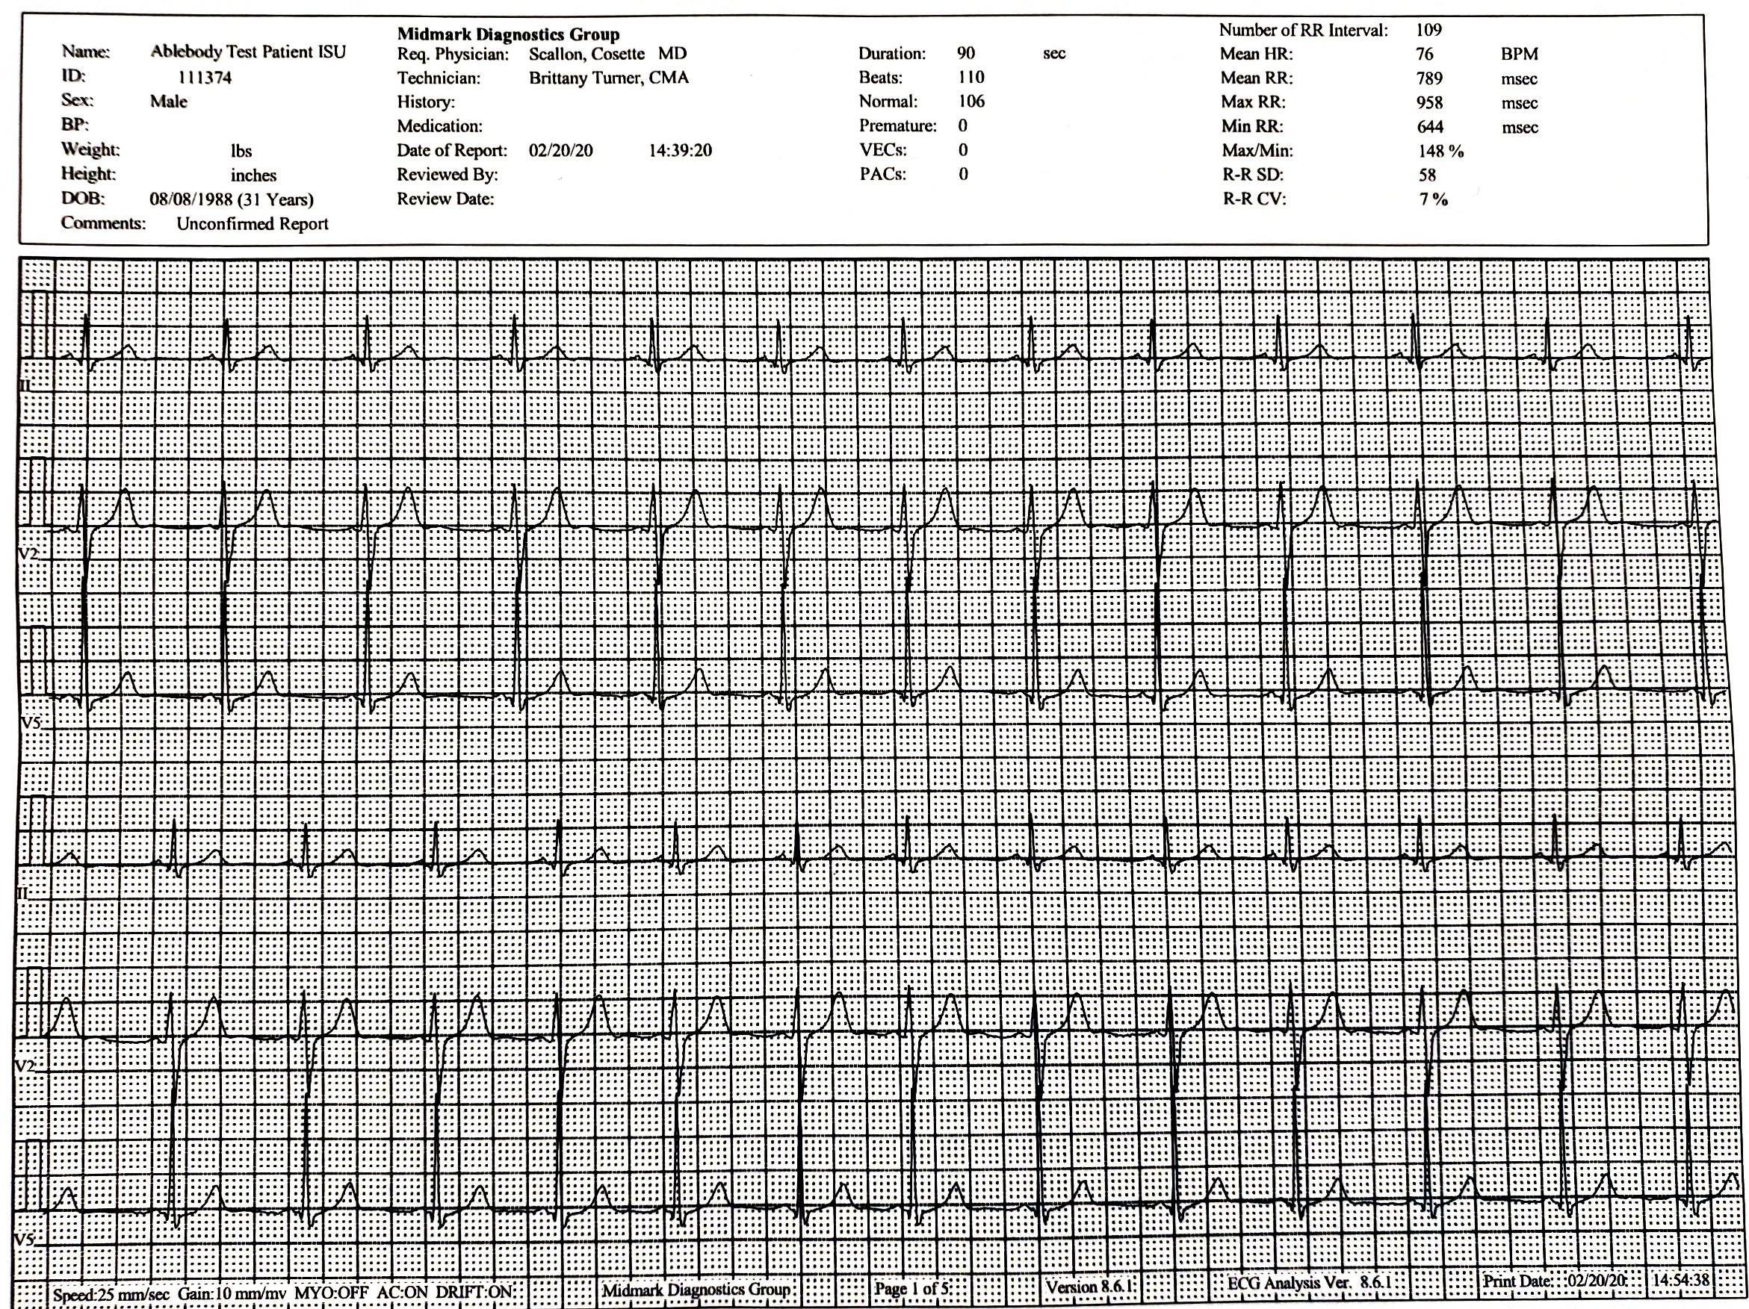
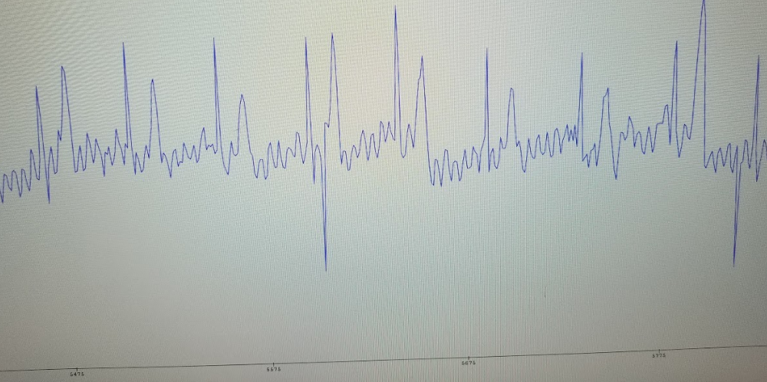
Our Results
Wearable Cardiac Monitor Team 24-Ruiyu
Notes:
Ruiyu
Top left corner is from last semester
Bottom left corner is our data
Inconsistency on the left of our data is from movement
Right side is from Student Health Center

Slide 15
Engineering Standards and Design Practices
IEEE Standards
Circuit and Block Diagrams
Agile practice & values
Commenting on Code
Wearable Cardiac Monitor Team 24-Peyton
Notes:
Peyton

Slide 16
How Switch Online Impacted Project
Unable to package the final prototype its final product form
In person team meetings couldn't happen
Unable to do as much physical testing due to loss of lab access and equipment
We were unable to order/install some of the features we wanted
Wearable Cardiac Monitor Team 24-Peyton
Notes:
Peyton
With it being a hardware project, it was difficult to bring stuff together
Relying on Arduino for voltage regulator
Due to the virus and our schedule, we were unable to get the pcb board. This means that we don’t have the capability to recharge the battery that is used, and that we are relying on the arduino voltage regulator.

Slide 17
Demo Video
Wearable Cardiac Monitor Team 24-Andrew
Notes:
Andrew

Slide 18
Contributions
Software
Andrew O’Brien
Peyton Sher
Hardware
Ruiyu Sun
Scott Beard
Communications
Sam Kimball
Vincent Lazzaro
Client/Adviser
Dr. Cheng Huang
Wearable Cardiac Monitor Team 24-Andrew
Notes:
Andrew

Slide 19
Questions?
Wearable Cardiac Monitor Team 24

